Slide 1
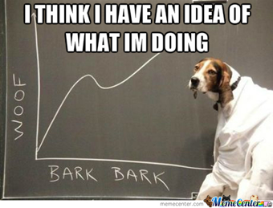
Drone delivery system unit
Day 7
Standards:
8.PS2.3
8PS2.4
8.PS2.5

Slide 2
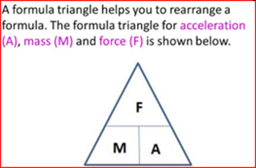

DQ
The acceleration due to gravity on Earth is 9.8 m/s2. The force acting on an object on Earth is 16 Newtons.
What is the mass of this object on Earth?
a. | Mass of the object is 2.6 kilograms
b. | The object’s mass is 156.8 kilograms
c. | Mass of the object is 1.63 kilograms
Standards: 8.PS2.3, 8PS2.4, 8.PS2.5

Slide 3
Check Answers
Construct an explanation to describe if this an example of balanced or unbalanced force.
Which mass had a greater impact force? Why?
5. How did the distance from which the ball was dropped affect the impact force?
6. Draw a free-body diagram to show the forces acting on the ball and explain the cause and effect relationship between mass and distance and how they affect impact force. How do mass
and distance affect gravity?
Standards: 8.PS2.3, 8PS2.4, 8.PS2.5

Slide 4
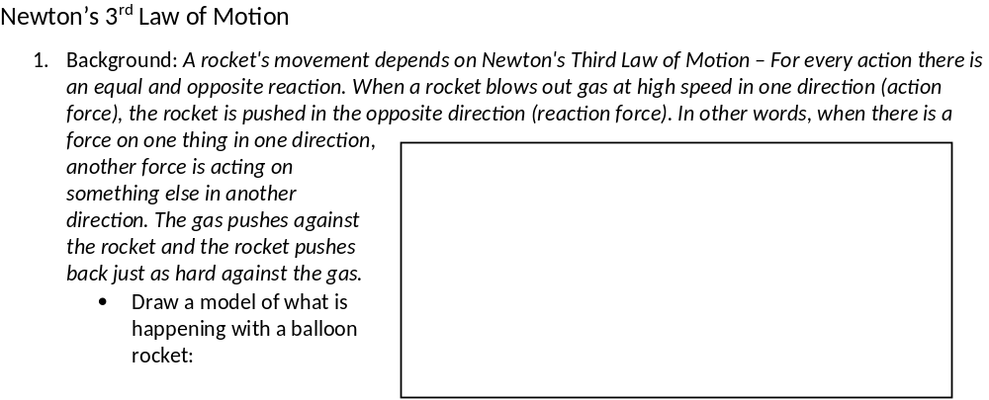
Standards: 8.PS2.3, 8PS2.4, 8.PS2.5

Slide 5

2. Objective: To have a balloon travel over a measured distance in the shortest possible time. The balloon will be attached to a soda straw. The soda straw will have a length of string running through it. The balloon will then travel along a length of fishing line or thread after being filled with air, and the air inside then being allowed to escape
3. Procedures:
1) Blow up the balloon and clamp it shut with the clothespin again.
2) Thread the string through the drinking straw. Tape the long side of the balloon along the length of the straw.
3) Make sure the string is stretched tight.
4) Slide the balloon-straw system down the string until the clamped end reaches the end of the string held by a person.
5) Release the clothespin. Record your observations. Complete at least 3 trials and record.
6) Blow up the balloon and repeat steps 4 and 5 but this time only fill the balloon half full of air. Repeat 3 times and record your data in the data table.
7) Calculate average distance traveled and average speeds for each test in the table below.
8) Answer the conclusion questions after you have completed the data table.
Standards: 8.PS2.3, 8PS2.4, 8.PS2.5

Slide 6
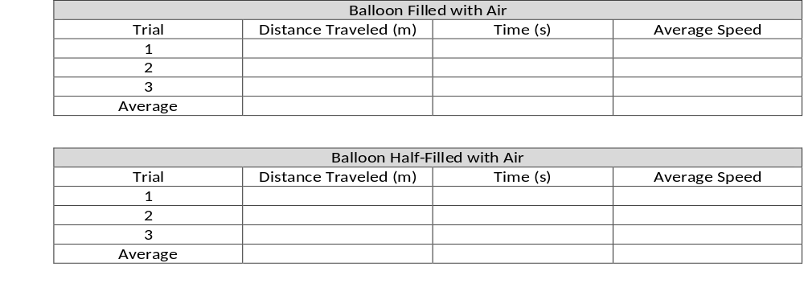
4. Data Tables:
Standards: 8.PS2.3, 8PS2.4, 8.PS2.5

Slide 7
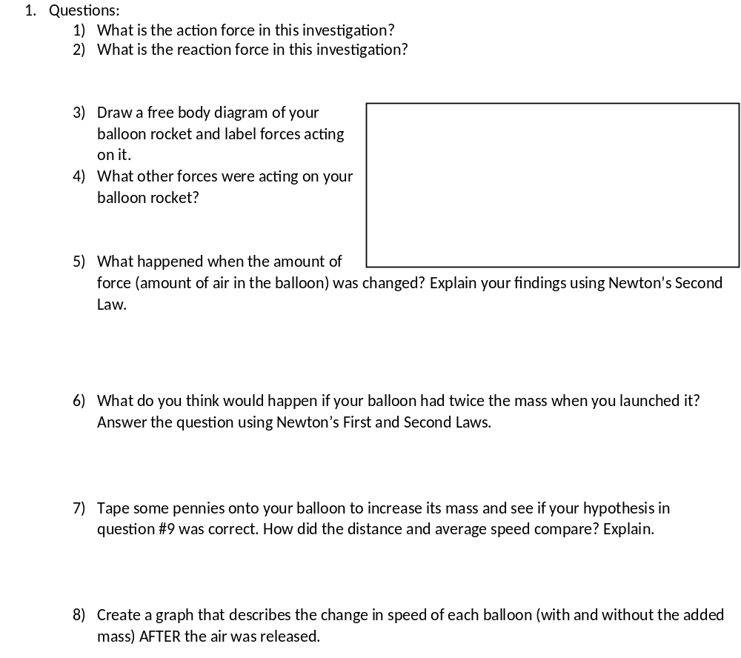
Standards: 8.PS2.3, 8PS2.4, 8.PS2.5

Slide 8
Revise your initial model

Slide 9
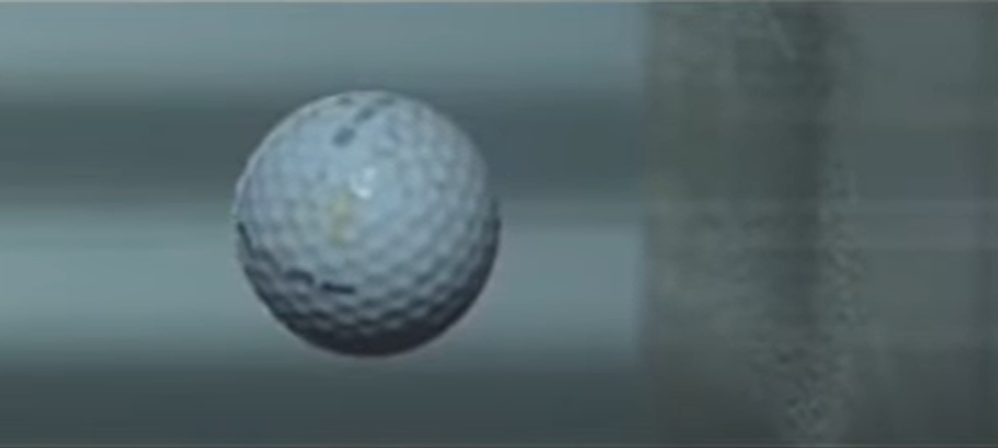
Colliding Objects Changing Shape
1. Today’s investigation will focus on how the shape of objects and their motion change in a
collision.
How will observing collisions help us better understand why the medical supplies are being damaged and to figure out how to prevent the medical supplies from being damaged?
What sort of things would we want to observe more closely in a collision that may or may not result in damage?
2. Watch this video of a golf ball hitting at 154 mph:

Slide 10
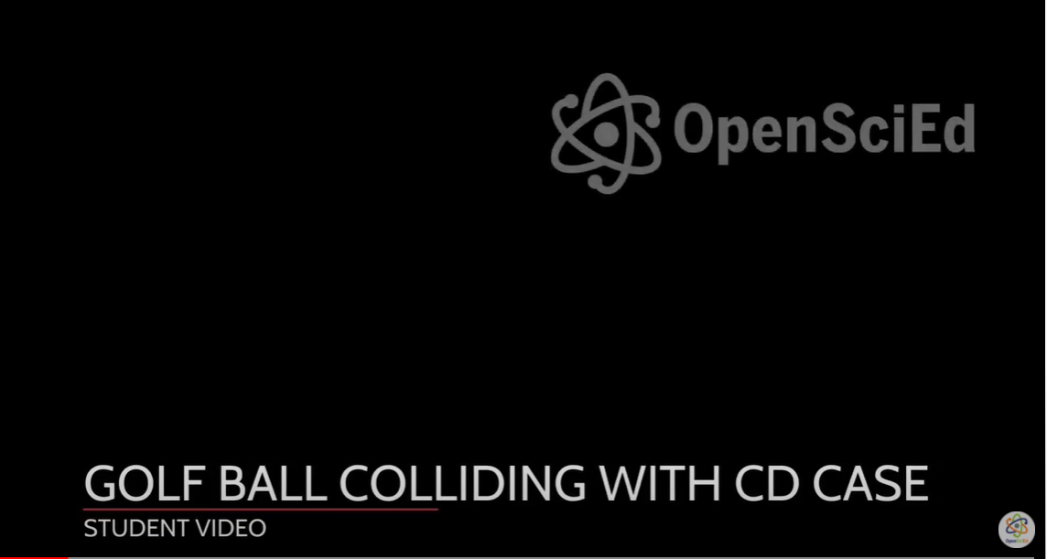
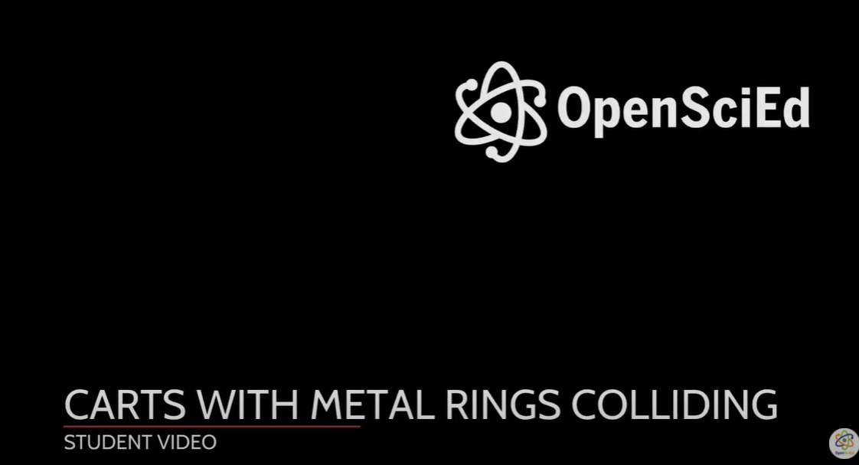
3. Watch the following two videos* and answer the question: What might be causing the changes in motion and changes in the shape of colliding objects?

Slide 11
Exit Ticket:
What is Newton’s 3rd Law of Motion?

